Slide 1
Hash Tables

Slide 2
Dictionary
Dictionary:
Dynamic-set data structure for storing items indexed using keys.
Supports operations Insert, Search, and Delete.
Applications:
Symbol table of a compiler.
Routing tables for network communication.
Associative arrays (python)
Page tables, spell checkers, document fingerprints, …
Hash Tables:
Effective implementations of dictionaries.

Slide 3
Dictionary by Direct-address Tables
Direct-address Tables are ordinary arrays.
Support direct addressing by key values.
Element whose key is k is obtained by indexing into the k^{th} position of the array.
Applicable when we can afford to allocate an array with one position for every possible key.
i.e. when the universe of keys U is small.
Dictionary operations (search, insert, delete) can be implemented to each take O(1) time.
Straightforward details in CLRS 11.1.

Slide 4
Dictionary by Hash Tables
Notation:
U – Universe of all possible keys.
K – Set of keys actually stored in the dictionary.
n = |K| << |U|.
Hash tables use arrays of size m = Θ(n):
Define functions that map keys to slots of the hash table.
Resolve collisions, since many keys map to same slot.
Support search, insert, delete, but not always O(1) worst-case.
Hash function h : U → {0,1,…, m–1} maps keys from U to the slots of a hash table T[0..m–1].
key k maps or “hashes” to slot T[h[k]].

Slide 5
Hashing
0
U
(universe of keys)
h(k₁)
h(k₄)
K
(actual
keys)
k₁
k₄
k₂
collision
h(k₂)
h(k₂)=h(k₅)
k₅
k₃
h(k₃)
m–1

Slide 6
Hash table design considerations
Memory (& cache) utilization
Hash function design
Minimize collisions by spreading keys evenly
Collisions must occur because we map many-to-one
Collision resolution
separate chaining CLRS 11.2
perfect hashing CLRS 11.5
open address with linear probing CLRS 11.4
open address with double hashing CLRS 11.4
cuckoo hashing http://en.wikipedia.org/wiki/Cuckoo_hashing
Worst- and average-case times of operations

Slide 7
5 Methods for Collision Resolution
Chaining: CLRS 11.2
Store all elements that hash to the same slot in a linked list.
Store pointer to linked list in hash table.
Open Addressing: CLRS 11.4
All elements stored in hash table itself.
On collision, use repeatable procedure to find a free slot in table for new key.
Linear chaining: store in next open slot
Double hashing: same, but step by a hash value, rather than by 1.
0
k₁
k₄
k₅
k₂
k₆
k₇
k₃
k₈
m–1

Slide 8
5 Methods for Collision Resolution
Perfect Hashing: CLRS 11.5
If keys are static, use a two-level hash: allocate j² space for any slot with j keys
Analysis shows total space is still O(n).
Cuckoo hashing
Use two hash functions to give each key two possible places.
On collision, bump existing element to its other place; may chain
if there is a cycle of bumps, rehash table with two new functions
k₁
k₄
k₅
k₂
k₇
k₆
k₃
k₄
k₅
k₁
k₆
k₇
k₂
k₃
k₄

Slide 9
Collision Resolution by Chaining
0
U
(universe of keys)
h(k₁)=h(k₄)
X
k₁
k₄
K
(actual
keys)
k₂
k₆
X
h(k₂)=h(k₅)=h(k₆)
k₅
k₈
k₇
k₃
X
h(k₃)=h(k₇)
h(k₈)
m–1

Slide 10
Collision Resolution by Chaining
0
U
(universe of keys)
k₁
k₄
k₁
k₄
K
(actual
keys)
k₂
k₆
k₅
k₂
k₆
k₅
k₈
k₇
k₃
k₇
k₃
k₈
m–1

Slide 11
Hashing with Chaining
Dictionary Operations:
Chained-Hash-Insert (T, x)
Insert x at the head of list T[h(key[x])].
Worst-case complexity: O(1).
Chained-Hash-Search (T, k)
Search an element with key k in list T[h(k)].
Worst-case complexity: proportional to length of list.
Chained-Hash-Delete (T, x)
Delete x from the list T[h(key[x])].
Worst-case complexity: search time + O(1).
Need pointer to preceding element, or a doubly-linked list.

Slide 12
Analysis of Chained-Hash-Search
Worst-case search time: time to compute h(k) + Θ(n).
Average time: depends on how h distributes keys among slots.
Assume
Simple uniform hashing.
Any key is equally likely to hash into any of the slots, independent of where any other key hashes to.
O(1) time to compute h(k).
Define Load factor α=n/m = average # of keys per slot.
n – number of keys stored in the hash table.
m – number of slots = # linked lists.

Slide 13
Expected Cost of an Unsuccessful Search
Theorem:
An unsuccessful search takes expected time Θ(1+α).
Assume: Any key not already in the table is equally likely to hash to any of the m slots.
Proof:
We must follow pointers to end of list T[h(k)], which has α items, so we expect 1+α pointer accesses.
Adding the time to compute the hash function, expected total time remains Θ(1+α).
Key fact: average bin size is α = n/m.

Slide 14
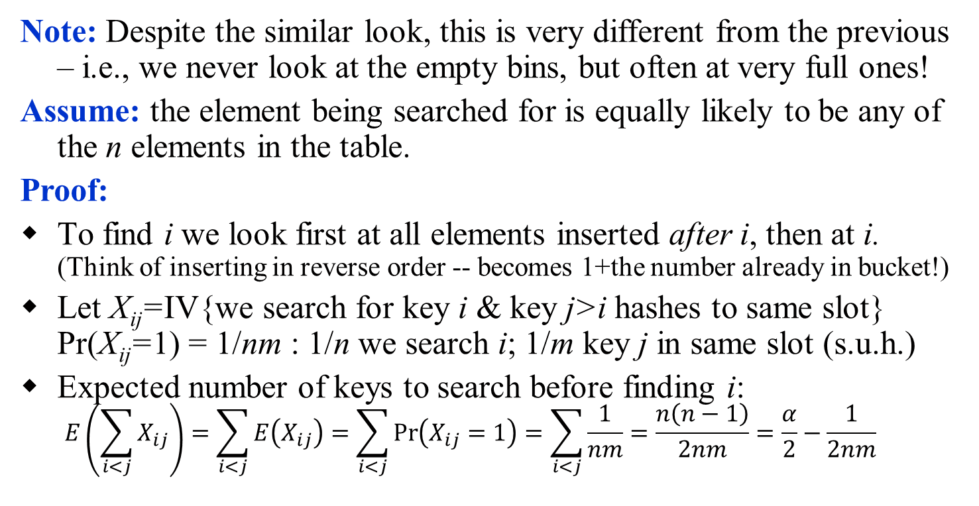
Expected Cost of a Successful Search
Theorem:
A successful search takes expected time Θ(1+α).
Note: Despite the similar look, this is very different from the previous – i.e., we never look at the empty bins, but often at very full ones!
Assume: the element being searched for is equally likely to be any of the n elements in the table.
Proof:
To find i we look first at all elements inserted after i, then at i. (Think of inserting in reverse order -- becomes 1+the number already in bucket!)
Let X_{ij}=IV{we search for key i & key j>i hashes to same slot} Pr(X_{ij}=1) = 1/nm : 1/n we search i; 1/m key j in same slot (s.u.h.)
Expected number of keys to search before finding i: $E\left(\sum_{i<j}{X_{ij}}\right)=\sum_{i<j}{E\left(X_{ij}\right)=\sum_{i<j}{\operatorname{Pr}\left(X_{ij}=1\right)=\sum_{i<j}{\frac{1}{nm}}=\frac{n\left(n−1\right)}{2nm}=\frac{α}{2}−\frac{1}{2nm}}}$

Slide 15
Bounding the Size of Longest List
Theorem: For the special case with m=n slots, with probability at least 1-1/n, the longest list is O(ln n / ln ln n).
Proof:
Let Z_{i,k}=IRV{key i hash to slot k} Pr(Z_{i,k}=1) = 1/m by s.u.h.
The probability that a particular slot k receives >κ keys is (letting m=n)
If we choose κ = 3 ln n / ln ln n, then κ! > n² and 1/κ! < 1/n².
Thus, the probability that any n slots receives >κ keys is < 1/n.
With probability at least 1-1/n,

Slide 16
Size of Longest List with 2 Choices
Theorem: Using m=n slots and 2 hash functions, placing each item in the shorter of the two lists, then with probability at least 1-1/n, the longest list is O(lg lg n).
Proof idea:
The height of a ball is i if it was the i-th ball to be placed in it's bin.
Note: (total # of balls of height i) ≥ (total # of bins with ≥ i balls)
Let α_{i} be the fraction of bins with ≥ i balls. Note α₂≤1/2.
Pr[ ball has height ≥ i + 1] ≤ α_{i}², since to place a ball at height i+1 we must select 2 bins of height ≥ i. So we expect α_{i+1} ≤ α_{i}².
We are unlikely to see more than i = O(lg lg n) balls in a bin.

Slide 17
Implications for separate chaining
If n = O(m), then load factor α=n/m = O(m)/m = O(1).
⇒ Search takes constant time on average.
Deletion takes O(1) worst-case time if you have a pointer to the preceding element in the list.
Hence, for hash tables with chaining, all dictionary operations take O(1) time on average, given the assumptions of simple uniform hashing and O(1) time hash function evaluation.
Extra memory (& coding) needed for linked list pointers.
Can we satisfy the simple uniform hashing assumption?

Slide 18
Good hash functions CLRS 11.2

Slide 19
Good Hash Functions
Recall the assumption of simple uniform hashing:
Any key is equally likely to hash into any of the slots, independent of where any other key hashes to.
O(1) time to compute h(k).
Hash values should be independent of any patterns that might exist in the data.
E.g. If each key is drawn independently from U according to a probability distribution P, we want
for all j ∈[0…m–1], ∑_{k:h(k) = j} P(k) = 1/m
Often use heuristics, based on the domain of the keys, to create a hash function that performs well.

Slide 20
Keys as Natural Numbers
Let’s assume that keys are natural numbers, even if we have to encode them to make it so.
Example: Interpret a character string as an integer expressed in some radix notation. E.g. “CLRS”:
ASCII values: C=67, L=76, R=82, S=83.
Use base 2⁷=128 to cover all basic ASCII values.
So, CLRS = 67·128³+76 ·128²+ 82·128¹+ 83·128⁰ = 141,764,947.
Why not just sum the ASCII values?
Horner’s Rule: CLRS p.41.

Slide 21
“Division Method” (mod p)
Map each key k into one of the m slots by taking the remainder of k divided by m. That is,
h(k) = k mod m
Example: m = 31 and k = 78 ⇒ h(k) = 16.
Advantage: Fast, since requires just one division operation.
Disadvantage: For some values, such as m=2^{p}, the hash depends on just a subset of the bits of the key.
Good choice for m:
Primes are good, if not too close to power of 2 (or 10).

Slide 22
Multiplication Method
Map each key k to one of the m slots indicated by the fractional part of k times a chosen real 0 < A < 1.
That is, h(k) = ⎣m (kA mod 1)⎦ = ⎣m (kA – ⎣kA⎦) ⎦
Example: m = 1000, k = 123, A ≈ 0.6180339887…
h(k) = ⎣1000(123 · 0.6180339887 mod 1)⎦
= ⎣1000 · 0.018169... ⎦ = 18.
Disadvantage: A bit slower than the division method.
Advantage: Value of m is not critical.
Details on next slide

Slide 23
Multiplication Mthd. – Implementation
Simple implementation for m a power of 2.
Choose m = 2^{p}, for some integer p.
Let the word size of the machine be w bits.
Pick a w-bit 0 < s < 2^{w}. Knuth suggests (√5 – 1)·2^{w-1}.
Let A = s/2^{w}. (We need 0<A<1.)
Assume that key k fits into a single word. (k takes w bits.)
Compute k × s = r₁ ·2^{w}+ r₀
The integer part of kA = r₁ , drop it.
Take the first p bits of r₀ by ⎣r₀ << p⎦
w bits
k
binary point
×
s = A·2^{w}
r₁
·
r₀
extract p bits
h(k)
Notes:
Some values of A work better than others (want to mix bits); Some values of m are easier to work with than others (want to make floor/ceiling computations easy).

Slide 24
Universal Hashing
A malicious adversary who has learned the hash function can choose keys that map to the same slot, giving worst-case behavior.
Defeat the adversary using Universal Hashing
Use a different random hash function each time.
Ensure that the random hash function is independent of the keys that are actually going to be stored.
Ensure that the random hash function is “good” by carefully designing a class of functions to choose from.

Slide 25
Universal Set of Hash Functions
A finite collection of hash functions H, that map a universe of keys U into {0, 1,…, m–1}, is “universal” if, for every pair of distinct keys k,l∈U, the number of h∈H with h(k)=h(l) is ≤ |H|/m.
Key idea: use number theory to pick a large set H where choosing h∈H at random makes Pr{h(k)=h(l) } = 1/m. (A random h can be expected to satisfy simple uniform hashing.)
With table size m, pick a prime p ≥ the largest key.
Define a set of hash functions for a,b∈[0…p–1], a>0,
h_{a,b}(k) = ( (ak + b) mod p) mod m.
Related to linear conguential random number generators (CLRS 31)

Slide 26
Example Set of Universal Hash Fcns
With table size m, pick a prime p ≥ the largest key.
Define a set of hash functions for a,b∈[0…p–1], a>0,
h_{a,b}(k) = ( (ak + b) mod p) mod m.
Claim: H is a 2-universal family.
Proof: Let's fix r≠s and calculate, for keys x ≠ y, Pr([(ax + b) = r (mod p)] AND [(ay+b) = s (mod p)]). We must have a(x–y) = (r–s) mod p, which is uniquely determines a over the field Z_{p}⁺, so b = r–ax (mod p). Thus, this probability is 1/p(p–1).
Now, the number of pairs r≠s with r = s (mod m) is p(p–1)/m, so Pr[(ax+b mod p) = (ay+b mod p) (mod n)] = 1/m.
QED

Slide 27
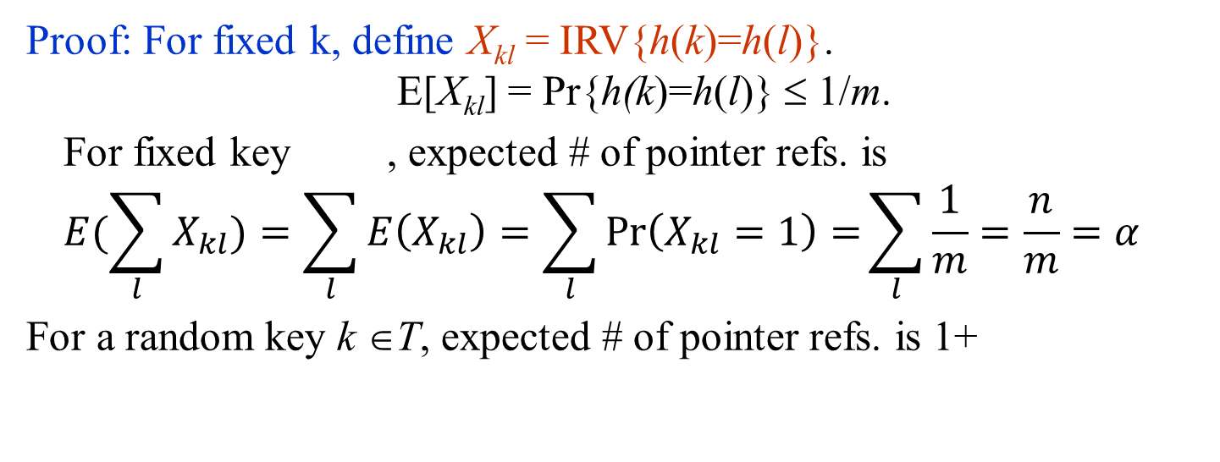
Chain-Hash-Search with Universal Hashing
Theorem:
Using chaining and universal hashing on key k:
If k is not in the table T, the expected length of the list that k hashes to is ≤ α.
If k is in the table T, the expected length of the list that k hashes to is ≤ 1+α.
Proof: For fixed k, define X_{kl} = IRV{h(k)=h(l)}. E[X_{kl}] = Pr{h(k)=h(l)} ≤ 1/m.
For fixed key , expected # of pointer refs. is
$$E(\sum_{l}{X_{kl})=\sum_{l}{E\left(X_{kl}\right)=\sum_{l}{\operatorname{Pr}\left(X_{kl}=1\right)=}}}\sum_{l}{\frac{1}{m}=\frac{n}{m}=α}$$
For a random key k ∈T, expected # of pointer refs. is 1+
$$E(\sum_{k<l}{\frac{X_{kl}}{n})=\sum_{k<l}{\frac{E\left(X_{kl}\right)}{n}=\frac{1}{n}\sum_{k<l}{\operatorname{Pr}\left(X_{kl}=1\right)=}}}\sum_{k<l}{\frac{1}{nm}=\frac{n(n−1)}{2nm}=\frac{α}{2}−\frac{1}{2nm}}$$

Slide 28
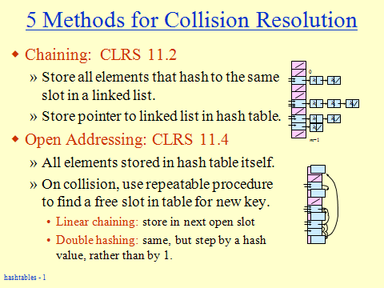
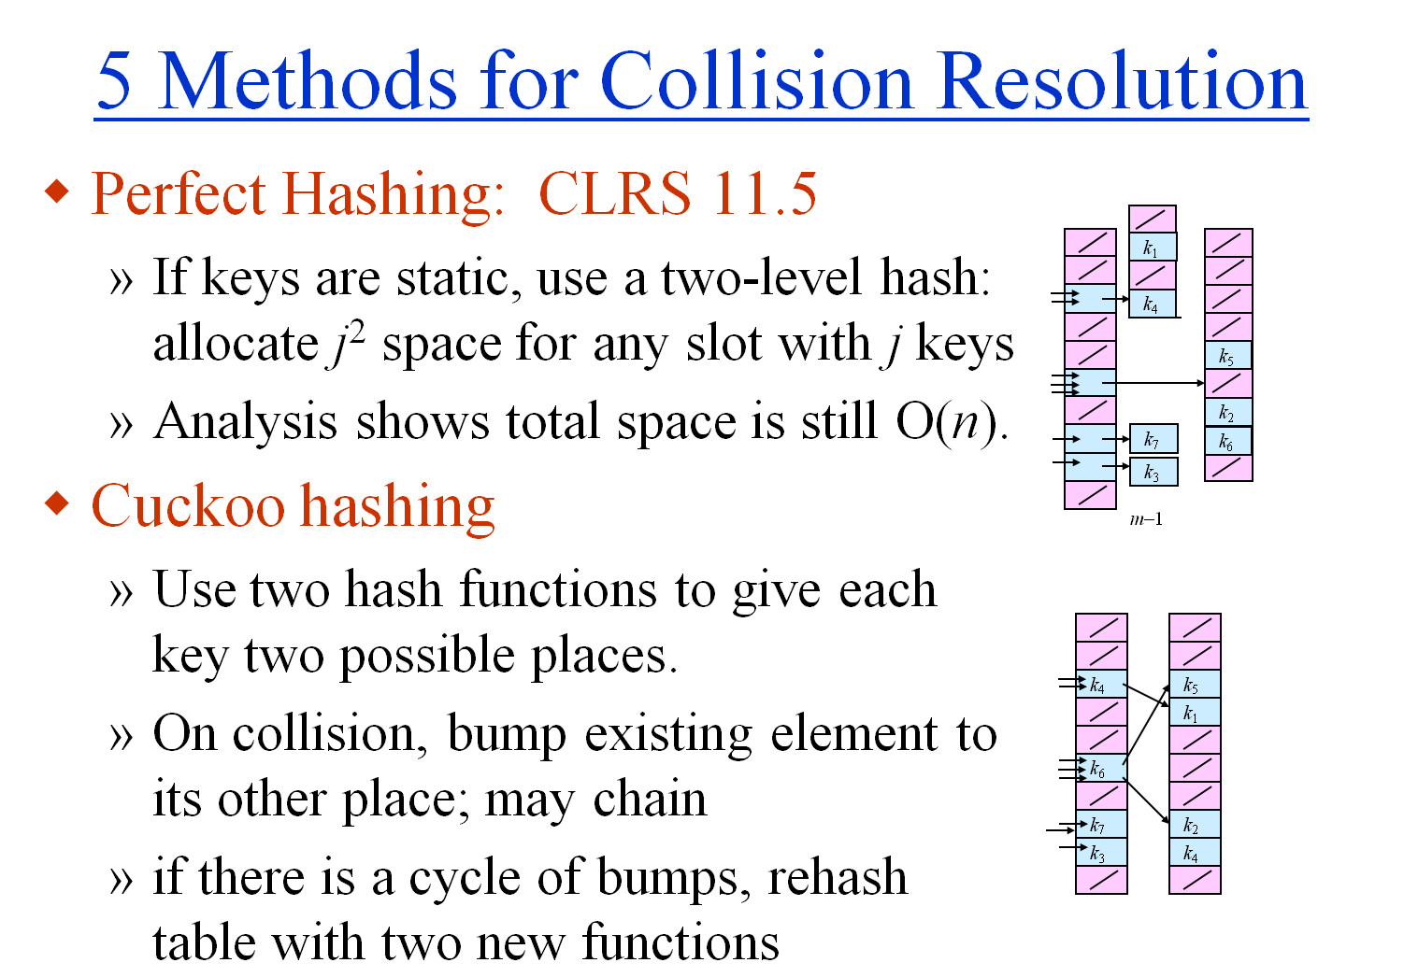
Back to hash tables

Slide 29
Perfect Hashing [FKS82]
k₁
U
(universe of keys)
k₄
k₁
k₄
k₅
K
(actual
keys)
k₂
k₆
k₅
k₃
k₇
k₂
k₇
k₆
k₃

Slide 30
Two consequences of
Recall our analyses for search with chaining: we let X_{ij}=IRV{keys i & j hash to same slot}
Consider m = n²:
If the average # of collisions < ½, then more than half the time we have no collisions!
Pick a random universal hash function and hash into table with m= n². Repeat until no collision.
Note: Thm. 11.9 in CLRS; uses Markov inequality in proof.

Slide 31
Two consequences of
Consider m=n:
We can show that (list sizes)² add up to O(n)
Let Z_{i,k}=IRV{key i hashes to slot k}
Let X_{ij}=IRV{keys i & j hash to same slot}
Note: Thm. 11.10 in CLRS.

Slide 32
Two consequences of
Let Z_{i,k}=IRV{key i hashes to slot k} Let X_{ij}=IRV{keys i & j hash to same slot}

Slide 33
Perfect Hashing
If you know the n keys in advance, makes a hash table with O(n) size, and worst-case O(1) lookup time.
Just use two levels of hashing: A table of size n, then tables of size n_{j}².
Dynamic versions have been created, but are usually less practical than other hash methods.
Key idea: exploit both ends of space/#collisions tradeoff.
k₁
k₄
k₅
k₂
k₇
k₆
k₃

Slide 34
Hash tables

Slide 35
Open Addressing
Idea:
Store all n keys in the m slots of the hash table itself. What can you say about the load factor α = n/m?
Each slot contains either a key or NIL.
To search for key k:
Examine slot h(k). Examining a slot is known as a probe.
If slot h(k) contains key k, the search is successful. If the slot contains NIL, the search is unsuccessful.
There’s a third possibility: slot h(k) contains a key that is not k.
Compute the index of some other slot, based on k and which probe we are on.
Keep probing until we either find key k or we find a slot holding NIL.
Advantages: Avoids pointers; so less code, and we can dedicate the memory to the table.

Slide 36
Probe Sequence
Sequence of slots examined during a key search constitutes a probe sequence.
Probe sequence must be a permutation of the slot numbers.
We examine every slot in the table, if we have to.
We don’t examine any slot more than once.
One way to think of it: extend hash function to:
h : U × {0, 1, …, m – 1} → {0, 1, …, m – 1}
probe number slot number

Slide 37
Operations: Search & Insert
Hash-Search (T, k)
1. i ← 0
2. repeat j ← h(k, i)
3. if T[j] = k
4. then return j
5. i ← i + 1
6. until T[j] = NIL or i = m
7. return NIL
Hash-Insert(T, k)
1. i ← 0
2. repeat j ← h(k, i)
3. if T[j] = NIL
4. then T[j] ← k
5. return j
6. else i ← i + 1
7. until i = m
8. error “hash table overflow”
Search looks for key k
Insert first searches for a slot, then inserts (line 4).

Slide 38
Deletion
Cannot just turn the slot containing the key we want to delete to contain NIL. Why?
Use a special value DELETED instead of NIL when marking a slot as empty during deletion.
Search should treat DELETED as though the slot holds a key that does not match the one being searched for.
Insert should treat DELETED as though the slot were empty, so that it can be reused.
Disadvantage: Search time is no longer dependent on α.
Hence, chaining is more common when keys have to be deleted.

Slide 39
Computing Probe Sequences
The ideal situation is uniform hashing:
Generalization of simple uniform hashing.
Each key is equally likely to have any of the m! permutations of ⟨0, 1,…, m–1⟩ as its probe sequence.
It is hard to implement true uniform hashing.
Approximate with techniques that guarantee to probe a permutation of [0…m–1], even if they don’t produce all m! probe sequences
Linear Probing.
Quadratic Probing.
Double Hashing.

Slide 40
Linear Probing
h(k, i) = (h′(k)+i) mod m.
The initial probe determines the entire probe sequence.
T[h′(k)], T[h′(k)+1], …, T[m–1], T[0], T[1], …, T[h′(k)–1]
Hence, only m distinct probe sequences are possible.
Suffers from primary clustering:
Long runs of occupied sequences build up.
Long runs tend to get longer, since an empty slot preceded by i full slots gets filled next with probability (i+1)/m.
Benefits from cache coherence
key
Probe number
Auxiliary hash function

Slide 41
Open addressing with linear probing
0
U
(universe of keys)
h(k₁)
h(k₄)
K
(actual
keys)
k₁
k₄
k₂
collision
h(k₂)
h(k₂)=h(k₅)
k₅
k₃
h(k₅)+1
h(k₃)
m–1

Slide 42
Quadratic Probing
h(k,i) = (h′(k) + c₁i + c₂i²) mod m c₁≠ c₂
The initial probe position is T[h′(k)], later probe positions are offset by amounts that depend on a quadratic function of the probe number i.
Must constrain c₁, c₂, and m to ensure that we get a full permutation of ⟨0, 1,…, m–1⟩.
Can suffer from secondary clustering:
If two keys have the same initial probe position, then their probe sequences are the same.
key
Probe number
Auxiliary hash function

Slide 43
Double Hashing
h(k,i) = (h₁(k) + i h₂(k)) mod m
Two auxiliary hash functions.
h₁ gives the initial probe. h₂ gives the remaining probes.
Must have h₂(k) relatively prime to m, so that the probe sequence is a full permutation of ⟨0, 1,…, m–1⟩.
Choose m to be a power of 2 and have h₂(k) always return an odd number. Or,
Let m be prime, and have 1 < h₂(k) < m.
Θ(m²) different probe sequences.
One for each possible combination of h₁(k) and h₂(k).
Close to the ideal uniform hashing.
key
Probe number
Auxiliary hash functions

Slide 44
Open addressing with double hashing
0
U
(universe of keys)
h₁(k₁)
=h₁(k₅)+ h₂(k₅)
h₁(k₄)
K
(actual
keys)
k₁
k₄
k₂
collision
h₁(k₂)
h₁(k₂)=h₁ (k₅)
k₅
k₃
h₁(k₃)
h₁(k₅)+ 2h₂(k₅)

Slide 45
CLRS Analysis of Open-address Hashing
The ideal situation is uniform hashing:
Generalization of simple uniform hashing.
Each key is equally likely to have any of the m! permutations of ⟨0, 1,…, m–1⟩ as its probe sequence.
It is hard to implement true uniform hashing.
Approximate with techniques that guarantee to probe a permutation of [0…m–1], even if they don’t produce all m! probe sequences
Linear Probing.
Quadratic Probing.
Double Hashing.

Slide 46
Analysis of Open-address Hashing
Analysis is in terms of load factor α = n/m.
Assumptions:
The table never completely fills, so n <m and α < 1.
uniform hashing (all probe sequences equally likely)
no deletion
In a successful search, each key is equally likely to be searched for.

Slide 47
Expected cost of an unsuccessful search
Theorem: Under the uniform hashing assumption, the expected number of probes in an unsuccessful search in an open-address hash table is at most 1/(1–α).
Proof:
Let P_{k}= IRV{the first k–1 probes hit occupied slots}
The expected number of probes is just
If α is a constant, search takes O(1) time.
Corollary: Inserting an element into an open-address table takes ≤ 1/(1–α) probes on average.

Slide 48
Expected cost of a successful search
Theorem: Under the uniform hashing assumption, the expected number of probes in a successful search in an open-address hash table is at most (1/α) ln (1/(1–α)).
Proof:
A successful search for a key k follows the same probe sequence as when k was inserted. Suppose that k was the (i+1)st key inserted.
At that time, α was i/m.
By the previous corollary, the expected number of probes inserting k was at most 1/(1–i/m) = m/(m–i).
We need to average over i=1..n, the positions for key k.

Slide 49
Analysis of Linear Probing [PPR07]
Pagh, Pagh, and Ruzic showed two things:
If pairs of keys hash to independent locations, but triples do not, then you can have expected Ω(log n) search time for linear probing.
If 5-tuples hash to independent locations, then you can guarantee expected O(1) search time for linear probing.

Slide 50
Sketch of analysis for m=3n [PPR07]
Imagine a binary tree over the hash table A[1..m]
A node at height i expects (1/3)·2^{i} items; call it dangerous if it has ≥(2/3)·2^{i} items.
If key k finds a run at h(k) of between 2^{i} and 2^{i+1} items, then the ancestor of h(k) at height i–2 is dangerous or has a dangerous sibling.
Now, we want the probability that a bin, of expected size μ=2^{i–2}/3, actually contains 2μ elements.
Pairs give bounds of O(1/μ), which is not enough, since Σ_{k} 2^{k}·O(1/2^{k-2}) = O(lg n).
Quadruples give O(1/μ²), and Σ_{k}2^{k}·O(1/2^{2(k-2)}) = Σ O(2^{-k}) = O(1).
Notes:
Linear probing. The relevance of moments to linear probing was only recognized in a recent breakthrough paper [Pagh, Pagh, Ruzic STOC'07]. I will show the analysis for b=3n to ease notation; it is easy to extend to any load. In true data-structures style, we consider a perfect binary tree spanning the array A[1..b]. A node on level k has 2^{k} array positions under it, and (1/3)·2^{k} items were originally hashed to them in expectation. (Here I am counting the original location h(x) of x, not where x really appears, which may be h(x)+1, h(x)+2, ...). Call the node "dangerous" if at least (2/3)·2^{k} elements hashed to it. Now say that we are dealing with element q (a query or an update). We must bound the contiguous run of elements that contain the position h(q). The key observation is that, if this run contains between 2^{k} and 2^{k+1} elements, either the ancestor of h(q) at level k-2 is dangerous, or one of its siblings in an O(1) neighborhood is dangerous. Let's say this run goes from A[i] to A[j], i≤h(q)≤j. The interval [i,j] is spanned by 4—9 nodes on level k-2. Assume for contradiction that none are dangerous. The first node, which is not completely contained in the interval, contributes less than (2/3)·2^{k-2} elements to the run (it the most extreme case, this many elements hashed to the last location of that node). But the next nodes all have more than 2^{k-2}/3 free locations in their subtree, so 2 more nodes absorb all excess elements. Thus, the run cannot go on for 4 nodes, contradiction. Now, the expected running time of an operation is clearly: Σ_{k} O(2^{k})·Pr[h(q) is in a run of 2^{k} to 2^{k+1} elements]. As argued above, this probability is at most O(1) times the probability that a designated node at level k-2 is dangerous. The rest is a simple balls-in-bins analysis: we want the probability that a bin, of expected size μ=2^{k-2}/3, actually contains 2μ elements. Last time, we showed that Chebyshev bounds this probability by O(1/μ). Unfortunately, this is not enough, since Σ_{k} 2^{k}·O(1/2^{k-2}) = O(lg n). However, if we go to the 4th moment, we obtain a probability bound of O(1/μ²). In this case, the running time is Σ_{k}2^{k}·O(1/2^{2(k-2)}) = Σ O(2^{-k}) = O(1). So the 4th moment is enough to make this series decay geometrically.

Slide 51
Hash tables

Slide 52
Cuckoo hashing [PR01]
Use two hash functions, h and g, to give each key two possible places.
I draw & analyze with two tables. You can cuckoo hash with a single table, but its harder to analyze.
Like open addressing, but displaces existing keys instead of probing.
On collision, bump existing element to its other place; may chain.
h
g
k₄
k₅
k₁
k₆
k₇
k₂
k₃
k₄

Slide 53
Collision Resolution in Cuckoo Hashing
h
g
U
(universe of keys)
k₄
k₅
k₁
k₁
k₄
K
(actual
keys)
k₂
k₆
k₆
k₅
k₃
k₇
k₈
k₈
k₇
k₂
k₃

Slide 54
Cuckoo Hashing
Dictionary Operations:
Cuckoo-Hash-Search (T, k)
Check at T[h(k)] and T[g(k)]
Worst-case complexity: only 2 locations to check = O(1).
Cuckoo-Hash-Delete (T, x)
Delete x from T[h(key[x])] or T[g(key[x])].
Worst-case complexity: O(1).
Cuckoo-Hash-Insert (T, x)
Try to insert initially at T[h(key[x])], displacing elements…
Worst-case: May need to rehash everything in O(n).
Average-case:

Slide 55
Cuckoo Hashing – Hash-Insert(T, x)
Use two universal hash functions, h and g, to give each key two possible locations.
On any collision, bump the existing item to its other location.
h(k) can start a chain of bumped items.
The chain can circle back and bump key k to its second location, g(k).
If you find yourself trying k at h(k) for the 2nd time, you have a double cycle -- rehash entire table, choosing two new universal hash fcns.
h
g
k₄
k₅
k₁
k₆
k₇
k₂
k₃
k₄

Slide 56
Analysis of Cuckoo-Hash-Insert
We want to count (how many ways can Cuckoo-Hash-Insert fail) (total number of possible states)
Mihai Patrascu counts bits to encode states, and upper bounds the bits to encode failure states.
http://infoweekly.blogspot.com/2010/02/cuckoo-hashing.html
The result is that each insert fails with probability < 1/n², so the probability of any failure is <1/n.
Expected rehash cost is therefore O(n)/n = O(1).

Slide 57
Hash tables

Slide 58
For more information
Knowing the contents of CLRS ch. 11 is enough for the course, but if you want to learn more about analyses for hashing not in CLRS:
2choice.pdf Notes from A. Gupta on M. Mitzenmacher’s 2 choice method.
Mihai Patrascu blog:
http://infoweekly.blogspot.com/2010/01/basic-hashtables.html
http://infoweekly.blogspot.com/2010/02/cuckoo-hashing.html
Anna Pagh, Rasmus Pagh, And Milan Ruzic: Linear Probing with Constant Independence, STOC’07
Adam Kirsch, Michael Mitzenmacher, Udi Wieder: More Robust Hashing: Cuckoo Hashing with a Stash. SIAM J. Comput. 39(4): 1543-1561 (2009)

